Slide 1

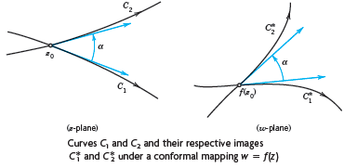
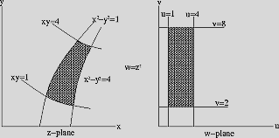
Conformal Mapping

Slide 4
Book: A First Course in Complex Analysis with Applications by Dennis G. Zill and
Patrick D. Shanahan.
Chapter 2: 2.3, 2.5
Chapter 4: 4.5
Chapter 7: 7.1, 7.2, 7.5
Book: Advanced Engineering Mathematics (9th Edition) by Ervin Kreyszig
Chapter 17: 17.1, 17.2, 17.3
Chapter 18: 18.1, 18.2, 18.3, 18.4

Slide 5
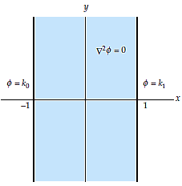
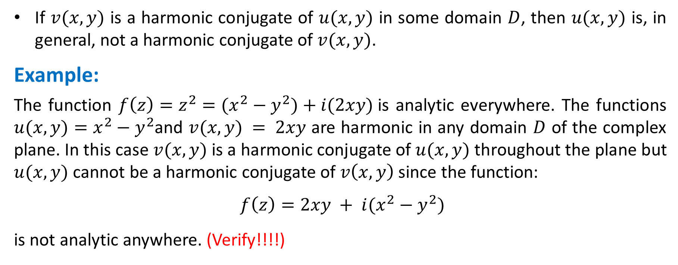
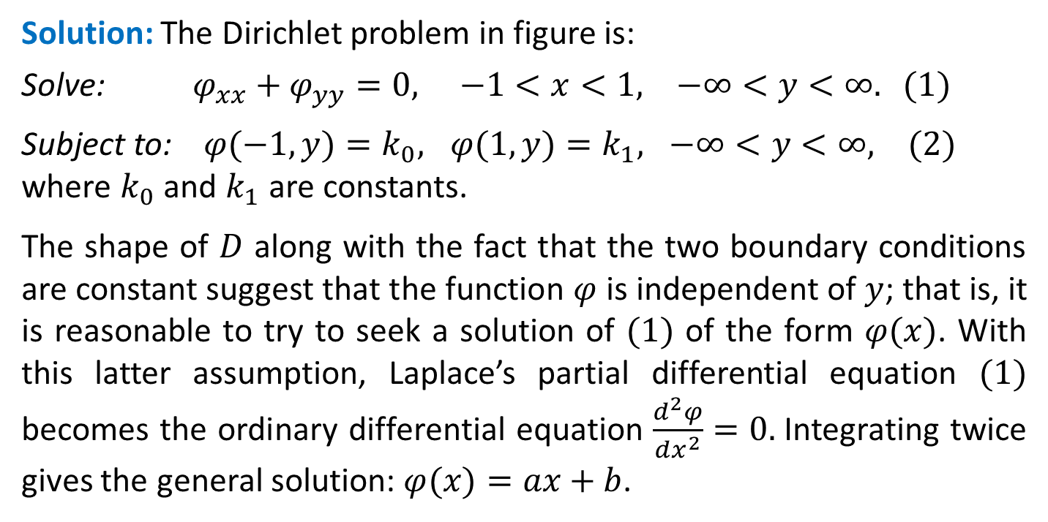
Example: Dirichlet Problem
Solve the Dirichlet problem illustrated in figure. The domain $D$ is a vertical infinite strip defined by $−1 < x < 1, −∞ < y < ∞$; the boundaries of D are the vertical lines $x = −1$and $x = 1$.
Solution: The Dirichlet problem in figure is:
Solve: $φ_{xx}+φ_{yy}=0, −1<x<1, −∞<y<∞. (1)$
Subject to: $φ(−1, y)=k_{0}, φ(1, y)=k_{1}, −∞<y<∞, (2)$
where $k_{0}$ and $k_{1}$ are constants.
The shape of $D$ along with the fact that the two boundary conditions are constant suggest that the function $φ$ is independent of $y$; that is, it is reasonable to try to seek a solution of $(1)$ of the form $φ(x)$. With this latter assumption, Laplace’s partial differential equation $(1)$ becomes the ordinary differential equation $\frac{d^{2}φ}{dx^{2}}=0.$Integrating twice gives the general solution: $φ(x)=ax+b$.

Slide 6
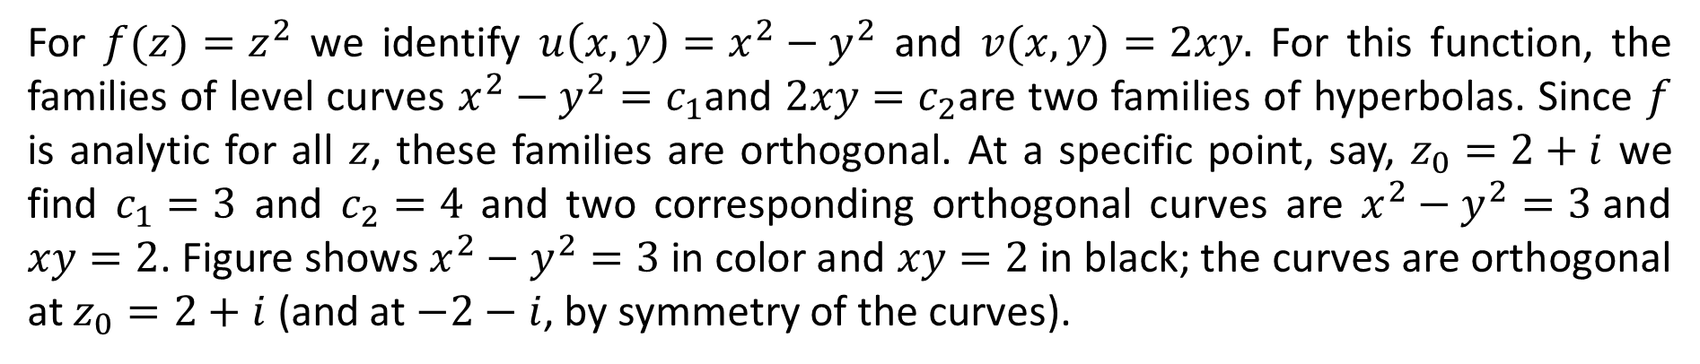
The boundary conditions enable us to solve for the coefficients $a$ and $b$. In particular, from $φ(−1)=k_{0}$ and $φ(1)=k_{1}$ we must have $a(−1)+b=k_{0}$ and $a(1)+b=k_{1}$, respectively. Adding the two simultaneous equations gives $2b=k_{0}+k_{1}$, whereas subtracting the first equation from the second yields $2a=k_{1}−k_{0}$. These two results give us $a$ and $b$. Therefore, we have the following solution of the given Dirichlet problem
$$φ\left(x\right)=\frac{k_{1}−k_{0}}{2}x+\frac{k_{1}+k_{0}}{2} (3)$$
Note that this problem can be interpreted as the determination the electrostatic potential $φ$ between two infinitely long parallel conducting plates that are held at constant potentials. Since it satisfies Laplace’s equation in $D$, $φ$ is a harmonic function. Hence a harmonic conjugate $ψ$ can be found as follows. Because $φ$ and $ψ$ must satisfy the Cauchy-Riemann equations, we have:
$ψ_{y}=φ_{x}=\frac{k_{1}−k_{0}}{2}$ and $ψ_{x}={−φ}_{y}=0.$
The second equation indicates that $ψ$ is a function of $y$ alone, and so integrating the first equation with respect to $y$ we obtain: $ψ\left(y\right)=\frac{k_{1}−k_{0}}{2}y,$ where, for convenience, we have taken the constant of integration to be 0.

Slide 7
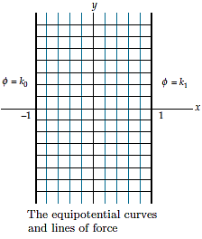

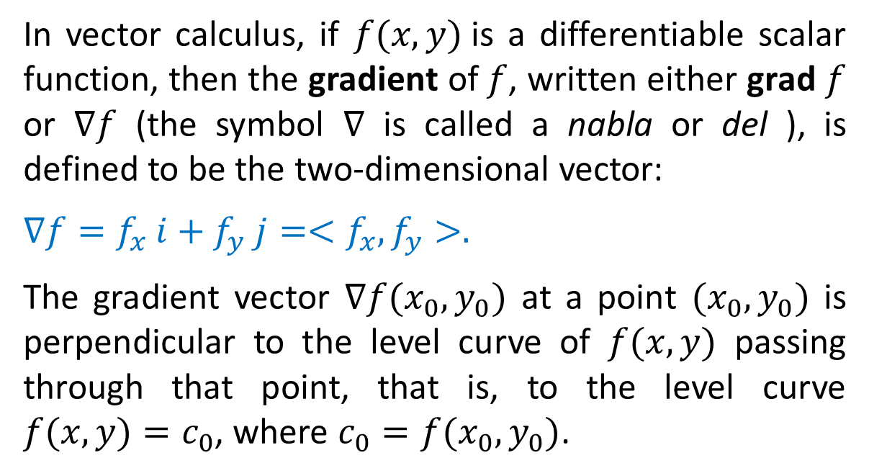
A complex potential function for the Dirichlet problem under consideration is then
$Ω\left(z\right)= φ\left(x\right)+ iψ\left(y\right)=\frac{k_{1}−k_{0}}{2}x+\frac{k_{1}+k_{0}}{2}+i\frac{k_{1}−k_{0}}{2}y$
The level curves of $φ$ or equipotential curves are the vertical lines $x=c_{1},$ shown in color in the figure, and the level curves of $ψ$ or the lines of force are the horizontal line segments $y=c_{2}$ shown in black. The figure clearly shows that the two families of level curves are orthogonal.

Slide 8
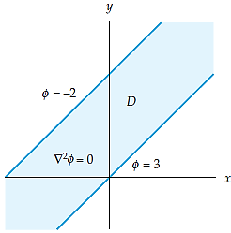
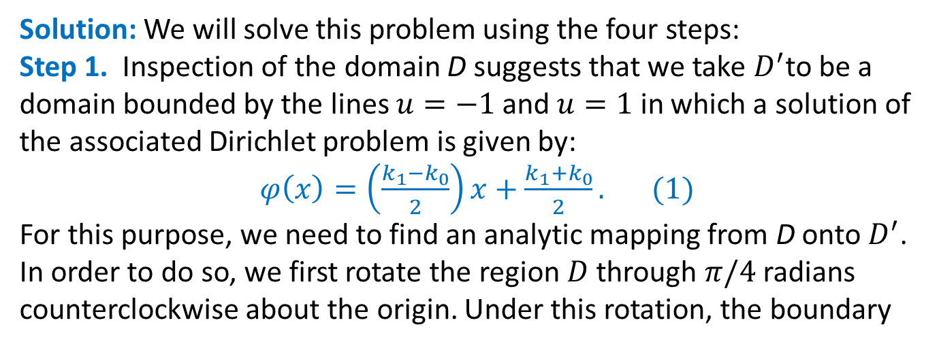
Example:
Let $D$ be the domain in the $z−$plane bounded by the lines $y=x$ and $y=x+2$. Find a function $φ(x,y)$ that is harmonic in $D$ and satisfies the boundary conditions $φ(x,x+2)=−2$ and $φ(x,x)=3$.
Solution: We will solve this problem using the four steps:
Step 1. Inspection of the domain D suggests that we take $D^{′}$to be a domain bounded by the lines $u=−1$ and $u=1$ in which a solution of the associated Dirichlet problem is given by:
$φ\left(x\right)=\left(\frac{k_{1}−k_{0}}{2}\right)x+\frac{k_{1}+k_{0}}{2}. (1)$
For this purpose, we need to find an analytic mapping from D onto $D^{′}$. In order to do so, we first rotate the region $D$ through $π/4$ radians counterclockwise about the origin. Under this rotation, the boundary
lines $y=x+2$ and $y=x$ are mapped onto the vertical lines $u=−\sqrt{2}$and $u=0,$ respectively. If we next magnify this domain by a factor of $\sqrt{2}$, we obtain a domain bounded by the lines $u=−2$ and $u=0$. Finally, we translate this image by $1$ in order to obtain a domain bounded by the lines $u=1$ and $u=−1$ as desired. Therefore, the domain $D$ is mapped onto the domain $D^{′}$ by the analytic function:
$$f(z)=T(M(R(z)))=\sqrt{2}e^{iπ/4}z +1=(1+i)z+1.$$
$$(2)$$

Slide 10
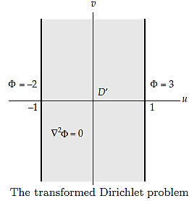

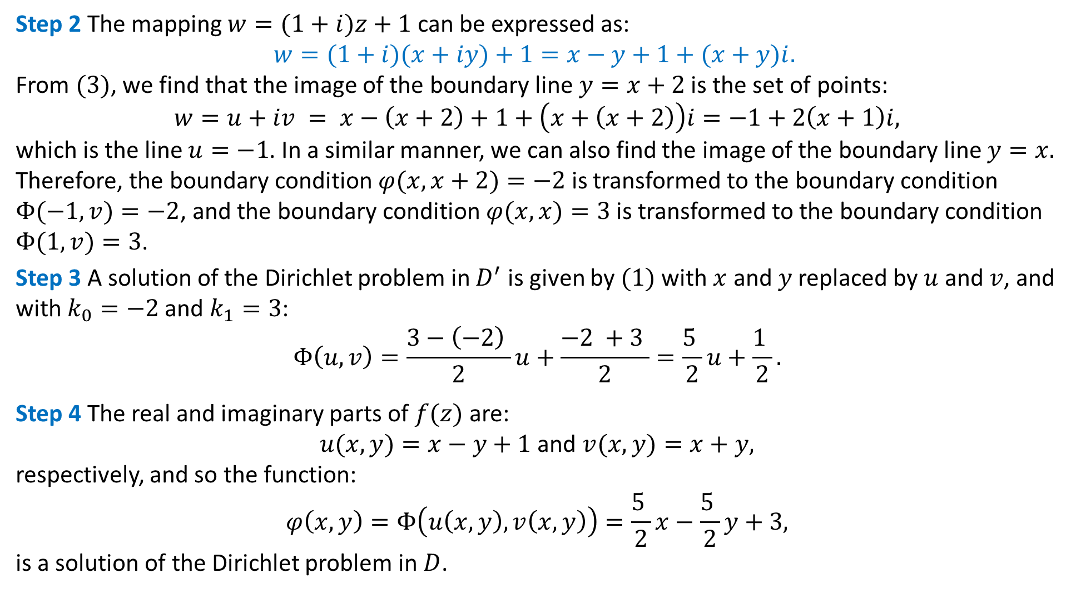
Step 2 The mapping $w=(1+i)z+1$ can be expressed as:
$$w=(1+i)(x+iy)+1=x−y+1+(x+y)i.$$
From $(3)$, we find that the image of the boundary line $y=x+2$ is the set of points:
$$w=u+iv = x−\left(x+2\right)+1+\left(x+\left(x+2\right)\right)i=−1+2\left(x+1\right)i,$$
which is the line $u=−1$. In a similar manner, we can also find the image of the boundary line $y=x.$ Therefore, the boundary condition $φ(x,x+2)=−2$ is transformed to the boundary condition $Φ(−1,v)=−2$, and the boundary condition $φ(x,x)=3$ is transformed to the boundary condition $Φ(1,v)=3$.
Step 3 A solution of the Dirichlet problem in $D^{′}$ is given by $(1)$ with $x$ and $y$ replaced by $u$ and $v$, and with $k_{0}=−2$ and $k_{1}=3$:
$$Φ\left(u, v\right)=\frac{3−\left(−2\right) }{2}u+\frac{−2 +3 }{2}=\frac{5 }{2}u+\frac{1 }{2}.$$
Step 4 The real and imaginary parts of $f(z)$ are:
$u(x,y)=x−y+1$ and $v(x,y)=x+y,$
respectively, and so the function:
$$φ\left(x, y\right)=Φ\left(u\left(x, y\right), v\left(x, y\right)\right)=\frac{5 }{2}x−\frac{5 }{2}y+3,$$
is a solution of the Dirichlet problem in $D$.
$$(3)$$

Slide 11
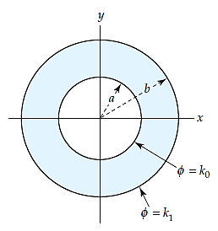
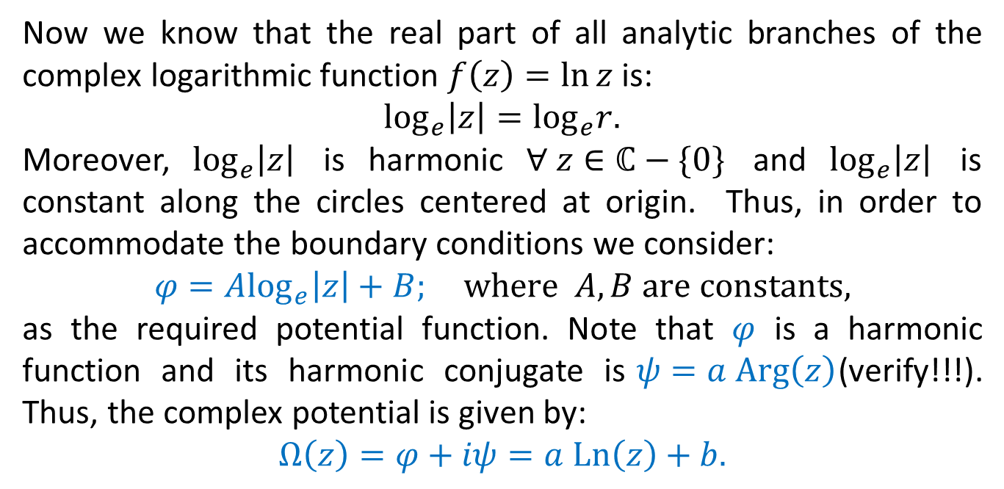
Example: Dirichlet for concentric cylinders
Determine the steady-state temperature between the two concentric circular conducting cylinders shown in figure.
Solution: From the given conditions, $φ(r,θ)$ is harmonic in $D$ and is constant along the boundary of the concentric conducting cylinders $.$
Now we know that the real part of all analytic branches of the complex logarithmic function $f\left(z\right)=\ln{z}$ is:
$\log_{e}\left|z\right|=\log_{e}r.$
Moreover, $\log_{e}\left|z\right|$ is harmonic $∀ z∈ℂ−\{0\}$ and $\log_{e}\left|z\right|$ is constant along the circles centered at origin. Thus, in order to accommodate the boundary conditions we consider:
$$φ=A\log_{e}\left|z\right|+B; where A,B are constants,$$
as the required potential function. Note that $φ$ is a harmonic function and its harmonic conjugate is$ψ=a Arg\left(z\right)$(verify!!!). Thus, the complex potential is given by:
$$Ω\left(z\right)=φ+iψ=a Ln\left(z\right)+b.$$
$Ω\left(z\right)$ can be interpreted as the complex potential of a source line (a wire perpendicular to the $xy−$plane) whose trace in the $xy−$plane is the origin.

Slide 13
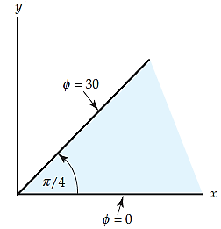

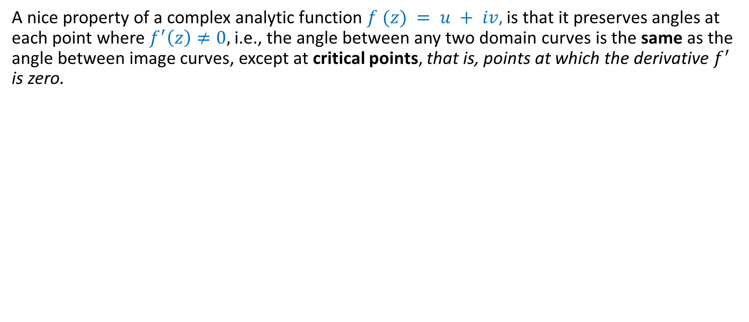
Example:
Determine a function$φ(x,y)$ between the two infinitely long conducting plates forming an infinite wedge as shown in figure
Solution:
Argument function $f\left(z\right)=\arg{z}$ can model this situation as it remains constant along the boundary edges and is harmonic being part of the complex logarithmic function. Thus, we can consider
$$φ\left(r,θ\right)=A\left(θ\right)+B; −π<θ≤π$$
as the required potential function.

Slide 14
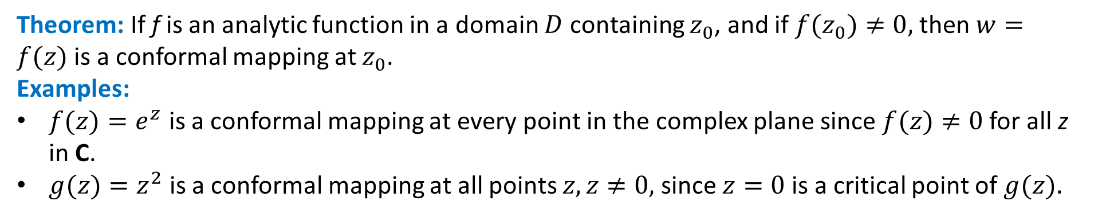
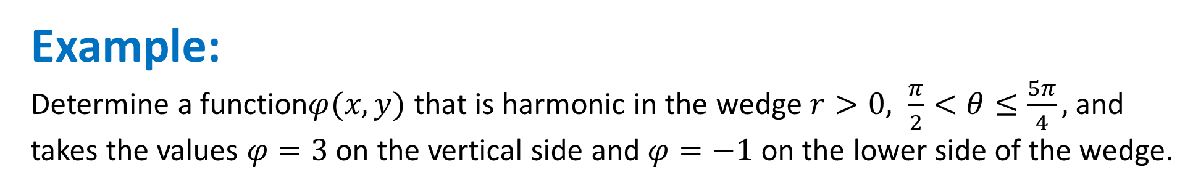
Example:
Determine a function$φ(x,y)$ that is harmonic in the wedge $r>0, \frac{π}{2}<θ≤\frac{5π}{4},$ and takes the values $φ=3$ on the vertical side and $φ=−1$ on the lower side of the wedge.
Solution:
Like the previous example, argument function $f\left(z\right)=\arg{z}$ can model this situation as it remains constant along the boundary edges and is harmonic being part of the complex logarithmic function. However, principal argument cannot be used because its branch cut lies in the region of interest. Thus, we can consider
$$φ\left(r,θ\right)=A\left(θ\right)+B; 0<θ≤2π.$$
as the required potential function.

Slide 15
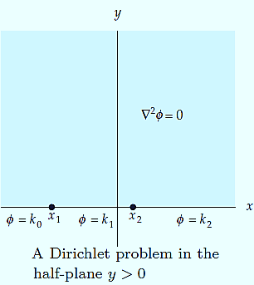
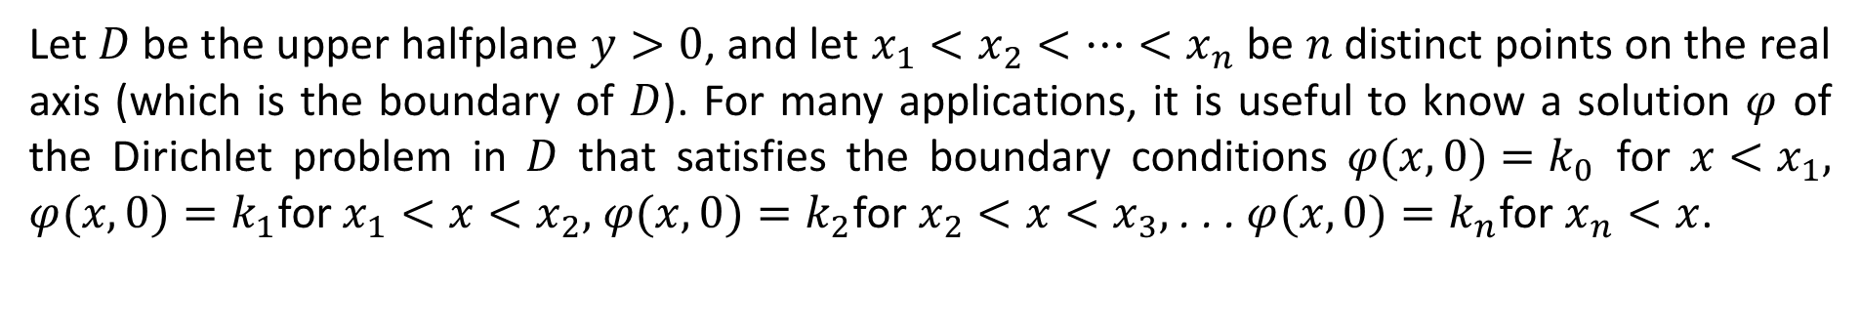
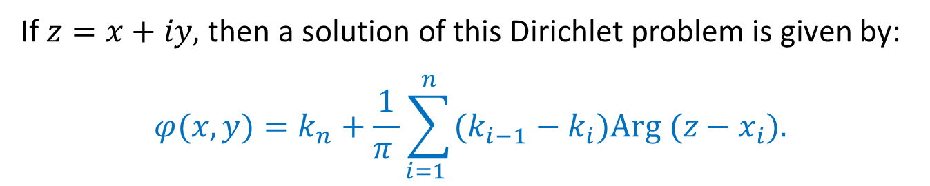

Dirichlet Problem in a Half-Plane
Let $D$ be the upper halfplane $y>0$, and let $x_{1}<x_{2}<…<x_{n}$ be $n$ distinct points on the real axis (which is the boundary of $D$). For many applications, it is useful to know a solution $φ$ of the Dirichlet problem in $D$ that satisfies the boundary conditions $φ(x,0)=k_{0}$ for $x<x_{1},$ $φ(x,0)=k_{1}$for $x_{1}<x<x_{2},$ $φ(x,0)=k_{2}$for $x_{2}<x<x_{3},$ . . . $φ(x,0)=k_{n}$for $x_{n}<x$.
If $z=x+iy,$ then a solution of this Dirichlet problem is given by:
$$φ(x, y)=k_{n}+\frac{1}{π }\sum_{i=1 }^{n}{(k_{i−1}−k_{i})Arg (z−x_{i}).}$$
$$(4)$$

Slide 17
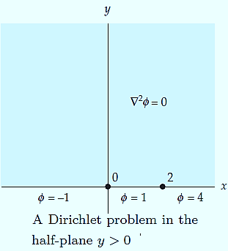
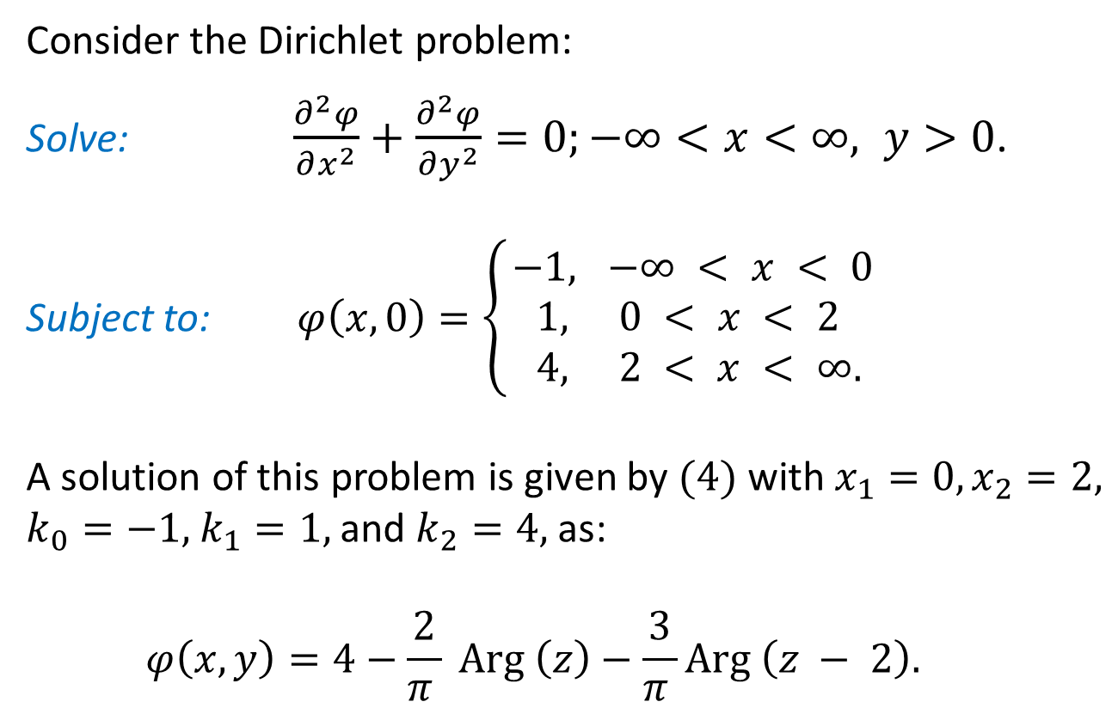
Example: Dirichlet Problem in a Half-Plane
Consider the Dirichlet problem:
Solve: $\frac{∂^{2}φ}{∂x^{2}}+\frac{∂^{2}φ}{∂y^{2}}=0;−∞<x<∞, y>0\text{.}$
Subject to: $φ\left(x,0\right)=\left\{\begin{aligned}−1, −∞ < x < 0 \\ 1, 0 < x < 2 \\ 4, 2 < x < ∞. \end{aligned}\right.$
A solution of this problem is given by $(4)$ with $x_{1}=0,x_{2}=2,$ $k_{0}=−1,$ $k_{1}=1,$ and $k_{2}=4,$ as:
$$φ\left(x, y\right)=4−\frac{2}{π } Arg \left(z\right)−\frac{3}{π }Arg \left(z − 2\right).$$

Slide 18
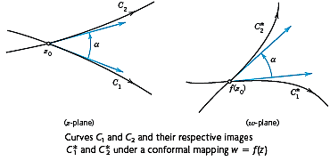
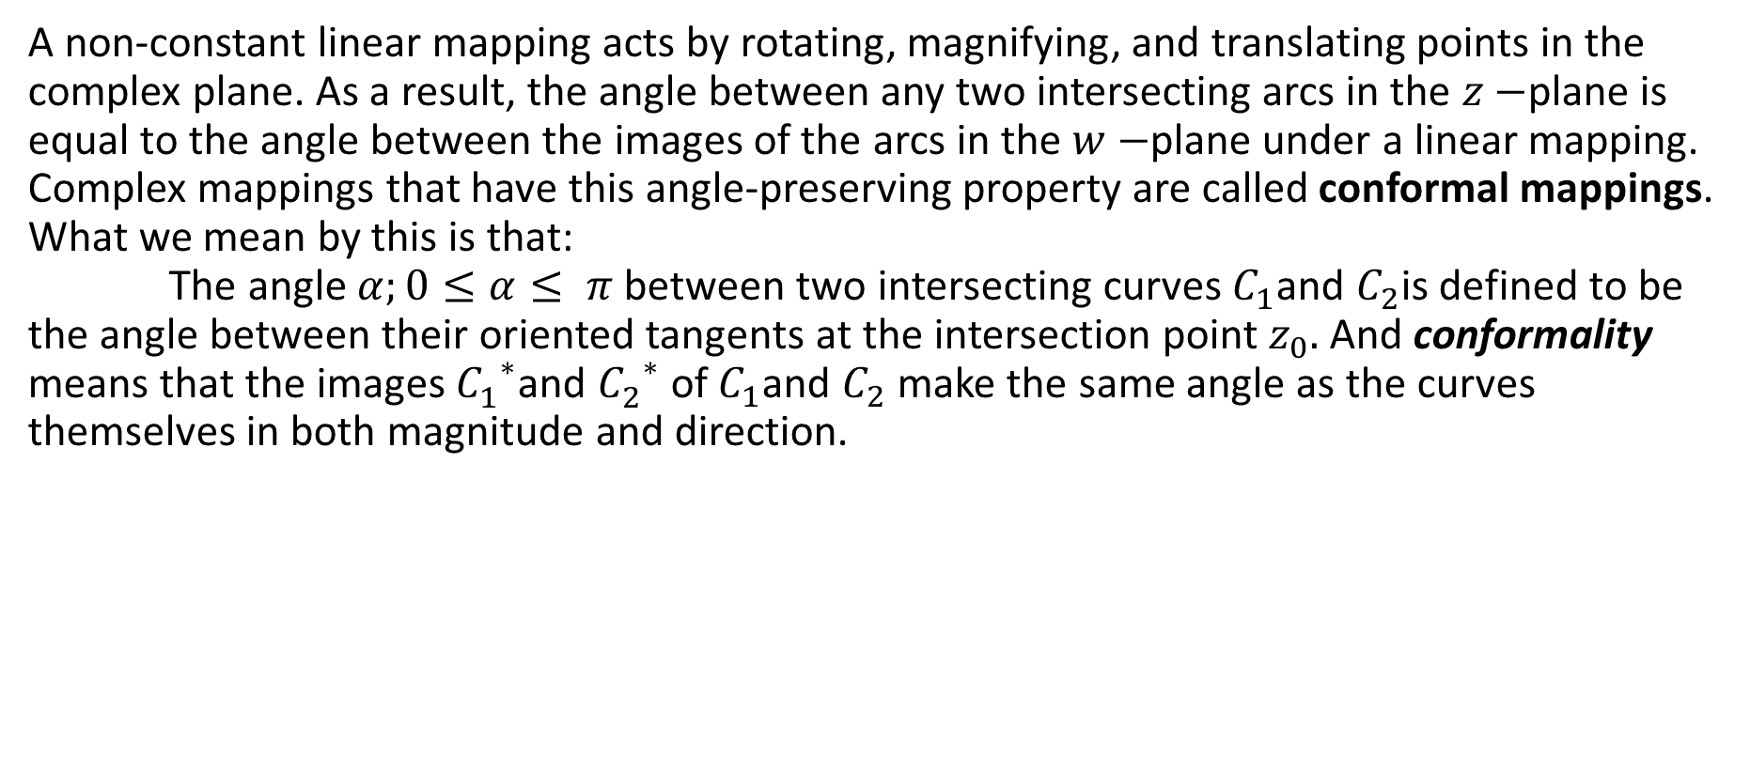
Conformal Mapping
A non-constant linear mapping acts by rotating, magnifying, and translating points in the complex plane. As a result, the angle between any two intersecting arcs in the $z−$plane is equal to the angle between the images of the arcs in the $w−$plane under a linear mapping. Complex mappings that have this angle-preserving property are called conformal mappings. What we mean by this is that: The angle $α;0≤α≤ π$ between two intersecting curves $C_{1}$and $C_{2}$is defined to be the angle between their oriented tangents at the intersection point $z_{0}.$ And conformality means that the images ${C_{1}^{}}^{∗}$and ${C_{2}^{}}^{∗}$ of $C_{1}$and $C_{2}$ make the same angle as the curves themselves in both magnitude and direction.

Slide 19
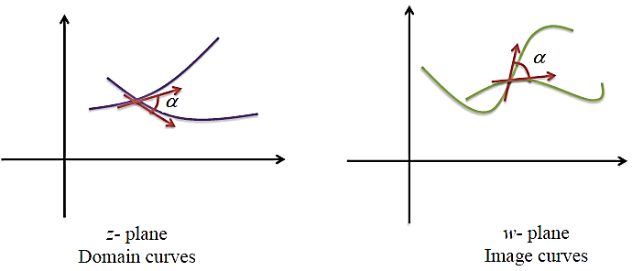
Conformal Behavior of Analytic Functions
A nice property of a complex analytic function $f (z) = u + iv,$is that it preserves angles at each point where $f^{′}\left(z\right)≠0,$ i.e., the angle between any two domain curves is the same as the angle between image curves, except at critical points, that is, points at which the derivative $f^{′}$ is zero.
Theorem: If f is an analytic function in a domain $D$ containing $z_{0}$, and if $f(z_{0})≠0,$ then $w=f(z)$is a conformal mapping at $z_{0}$.
Examples:
$f(z)=e^{z}$ is a conformal mapping at every point in the complex plane since $f(z)≠0$ for all z in C.
$g(z)=z^{2}$ is a conformal mapping at all points $z,z≠0,$ since $z=0$is a critical point of $g(z).$

Slide 20
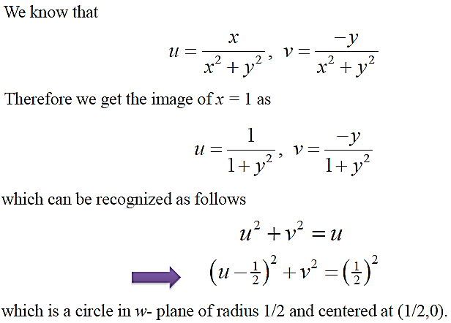
Example:
Let us see this by looking at the image curves $x = 1$and $y = 1$ under reciprocal function $w=f\left(z\right)=\frac{1}{z}.$
Solution:

Slide 21
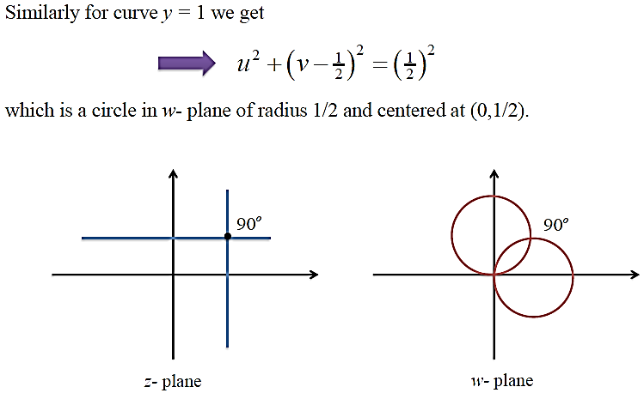
Note: From the example we make two important observations:
• an infinite line is mapped to a closed bounded (finite) circle
• the angle 90 is preserved under complex mappings

Slide 22
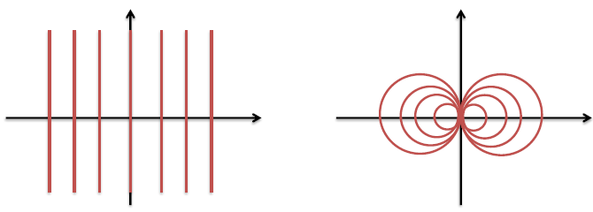
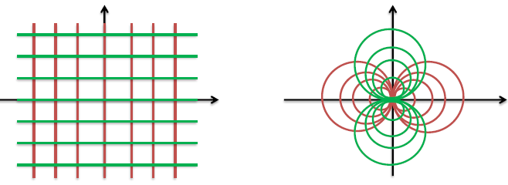
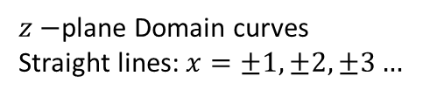


Therefore we conclude that :
• A complex mapping can be used to map un-bounded regions to bounded regions.
• A complex analytic function respects the invariance of angle between curves.
$z−$plane Domain curves
Straight lines: $x=±1, ±2, ±3…$
$w−$plane Image Pattern: Circles
$z−$plane Domain curves: Straight lines
$w−$plane Image Pattern: Circles

Slide 23
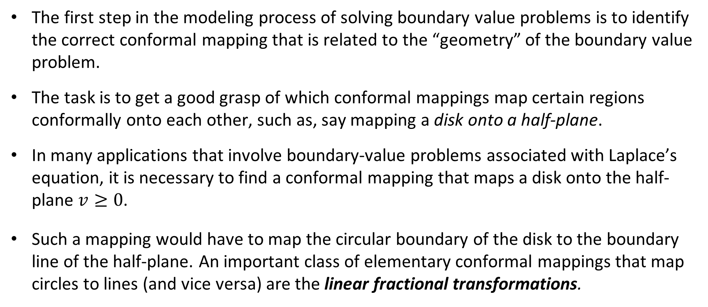
Linear Fractional Transformations
The first step in the modeling process of solving boundary value problems is to identify the correct conformal mapping that is related to the “geometry” of the boundary value problem.
The task is to get a good grasp of which conformal mappings map certain regions conformally onto each other, such as, say mapping a disk onto a half-plane.
In many applications that involve boundary-value problems associated with Laplace’s equation, it is necessary to find a conformal mapping that maps a disk onto the half-plane $v≥0$.
Such a mapping would have to map the circular boundary of the disk to the boundary line of the half-plane. An important class of elementary conformal mappings that map circles to lines (and vice versa) are the linear fractional transformations.

Slide 24

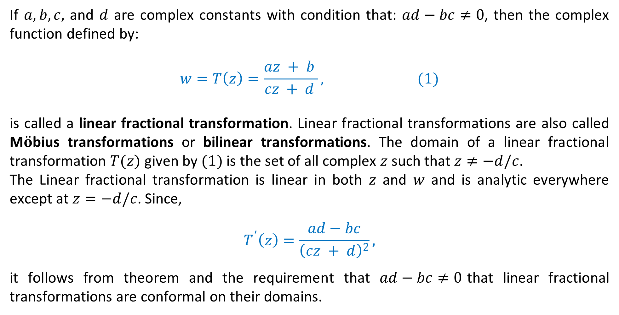
Linear Fractional Transformations
If $a,b,c,$ and $d$ are complex constants with condition that: $ad−bc≠0$, then the complex function defined by:
$$w=T\left(z\right)=\frac{az + b }{cz + d }, (1)$$
is called a linear fractional transformation. Linear fractional transformations are also called M$\ddot{o}$bius transformations or bilinear transformations. The domain of a linear fractional transformation $T(z)$ given by $(1)$ is the set of all complex $z$ such that $z≠−d/c$.
The Linear fractional transformation is linear in both $z$ and $w$ and is analytic everywhere except at $z=−d/c$. Since,
$$T^{′}\left(z\right)=\frac{ad−bc}{{\left(cz + d\right)}^{2}},$$
it follows from theorem and the requirement that $ad−bc≠0$that linear fractional transformations are conformal on their domains.
$$(2)$$

Slide 30
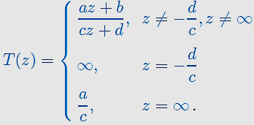
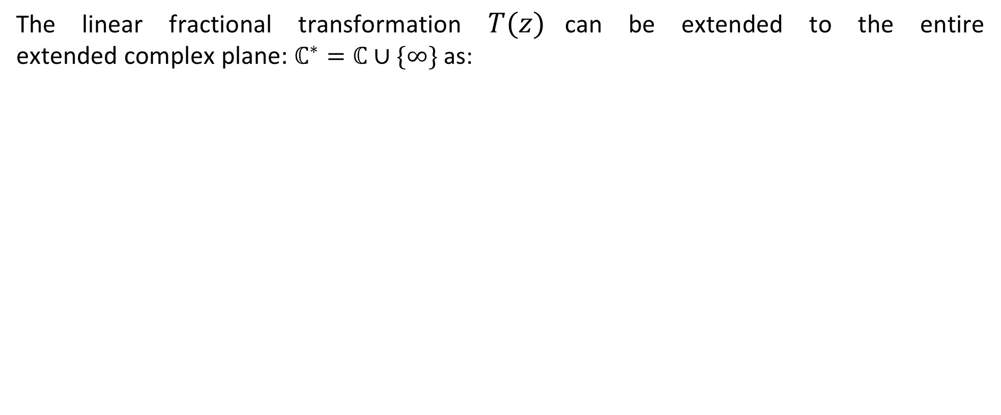

Linear Fractional Transformations
The linear fractional transformation $T(z)$can be extended to the entire extended complex plane: $ℂ^{∗}=ℂ∪\{∞\}$ as:
$$(3)$$
Here, $z=−d/c$ is the pole of $T(z)$ and $∞$ is called the ideal point.

Slide 31
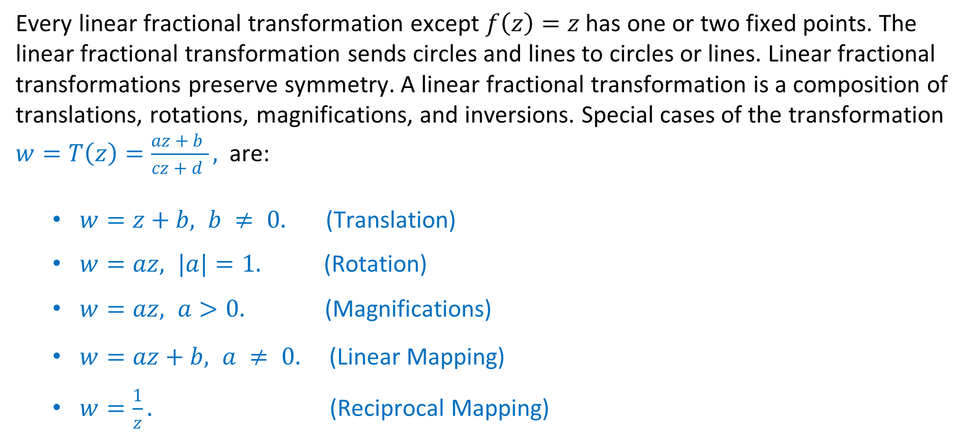
Linear Fractional Transformations
Every linear fractional transformation except $f\left(z\right)=z$ has one or two fixed points. The linear fractional transformation sends circles and lines to circles or lines. Linear fractional transformations preserve symmetry. A linear fractional transformation is a composition of translations, rotations, magnifications, and inversions. Special cases of the transformation $w=T\left(z\right)=\frac{az + b }{cz + d },$are:
$w=z+b, b ≠ 0.$ (Translation)
$w=az, |a|=1.$ (Rotation)
$w=az, a>0.$ (Magnifications)
$w=az+b, a ≠ 0.$ (Linear Mapping)
$w=\frac{1}{z}.$ (Reciprocal Mapping)

Slide 32
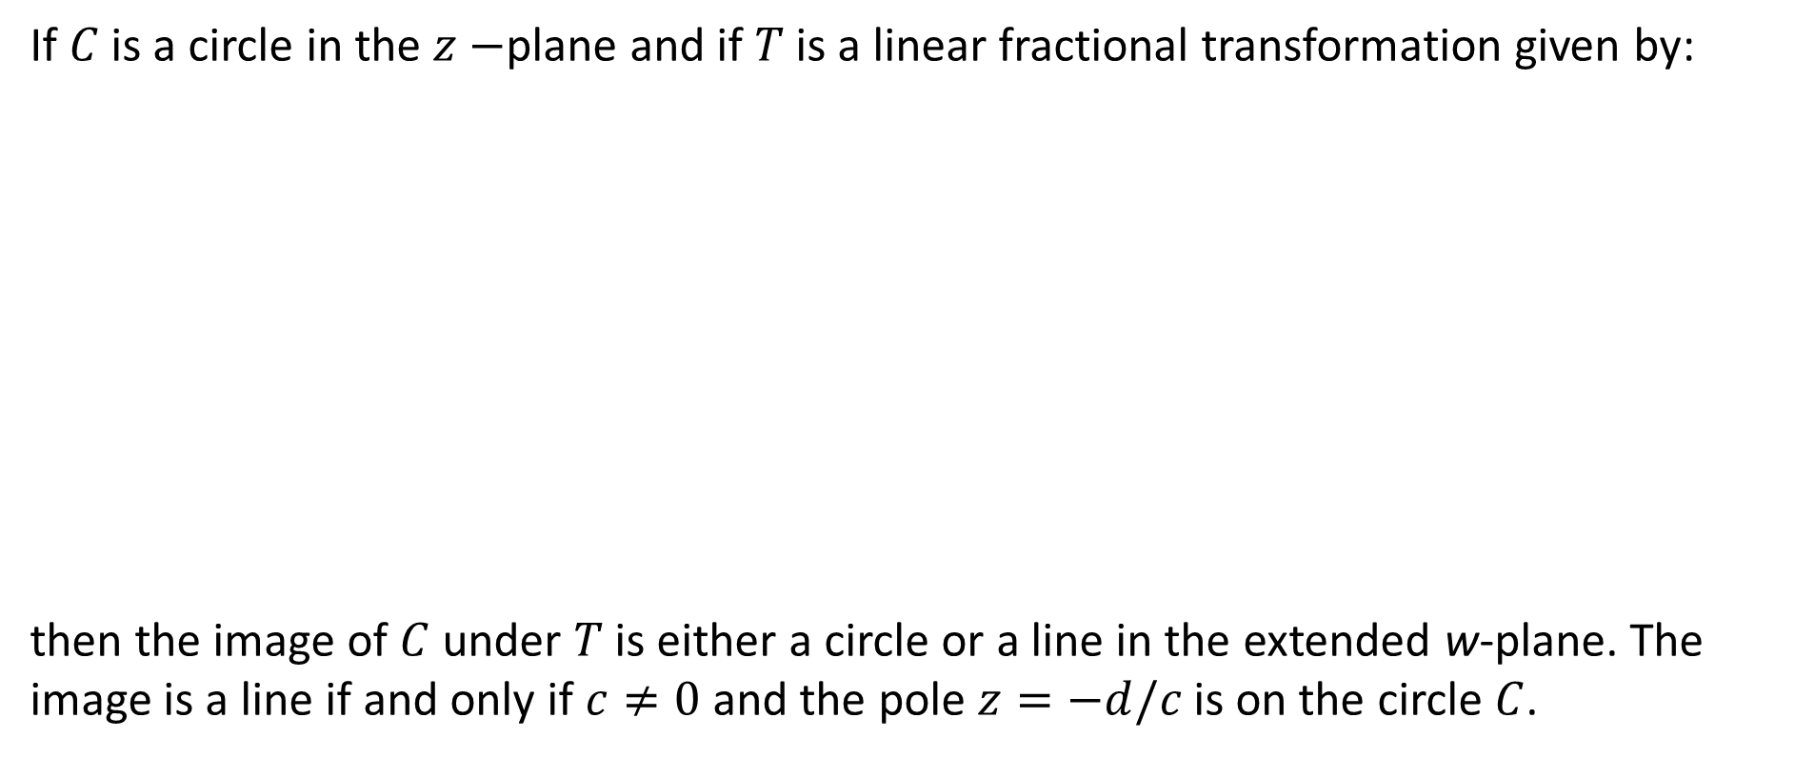

Theorem: Circles and Straight Lines
If $C$ is a circle in the $z−$plane and if $T$ is a linear fractional transformation given by:
then the image of $C$ under $T$ is either a circle or a line in the extended w-plane. The image is a line if and only if $c≠0$ and the pole $z=−d/c$is on the circle $C$.
$$(3)$$

Slide 33
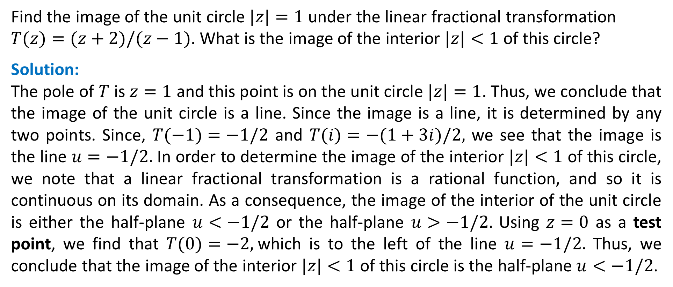
Example:
Find the image of the unit circle $|z|=1$ under the linear fractional transformation
$T(z)=(z+2)/(z−1)$. What is the image of the interior $|z|<1$ of this circle?
Solution:
The pole of $T$ is $z=1$ and this point is on the unit circle $|z|=1$. Thus, we conclude that the image of the unit circle is a line. Since the image is a line, it is determined by any two points. Since, $T(−1)=−1/2$ and $T(i)=−(1+3i)/2,$ we see that the image is the line $u=−1/2.$ In order to determine the image of the interior $|z|<1$ of this circle, we note that a linear fractional transformation is a rational function, and so it is continuous on its domain. As a consequence, the image of the interior of the unit circle is either the half-plane $u<−1/2$ or the half-plane $u>−1/2.$ Using $z=0$ as a test point, we find that $T(0)=−2,$which is to the left of the line $u=−1/2.$ Thus, we conclude that the image of the interior $|z|<1$ of this circle is the half-plane $u<−1/2$.

Slide 34
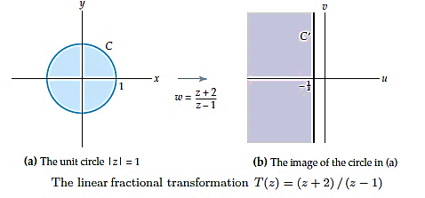

Slide 35
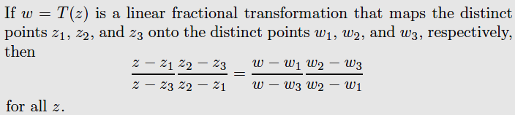
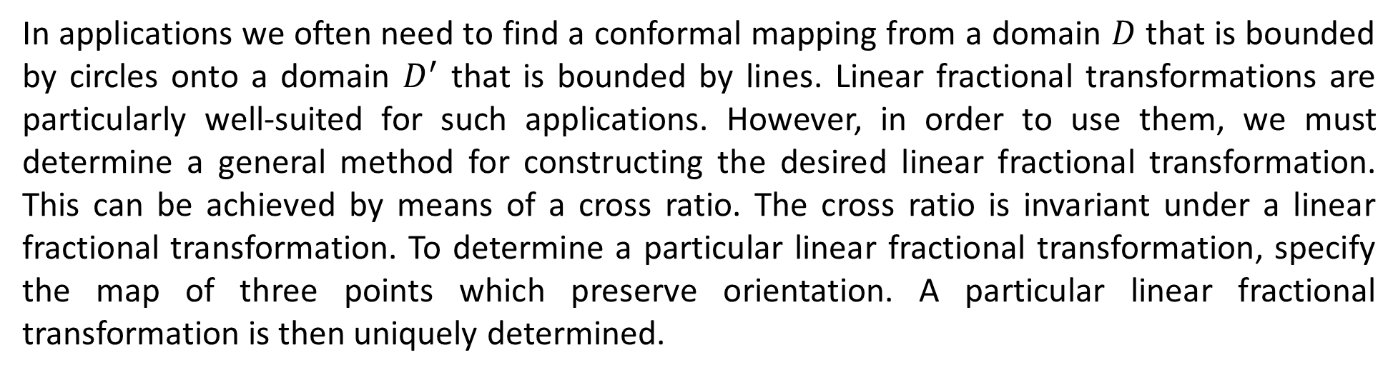
Cross-Ratios and Linear Fractional Transformations
In applications we often need to find a conformal mapping from a domain $D$ that is bounded by circles onto a domain $D^{′}$ that is bounded by lines. Linear fractional transformations are particularly well-suited for such applications. However, in order to use them, we must determine a general method for constructing the desired linear fractional transformation. This can be achieved by means of a cross ratio. The cross ratio is invariant under a linear fractional transformation. To determine a particular linear fractional transformation, specify the map of three points which preserve orientation. A particular linear fractional transformation is then uniquely determined.
Note: If one of these points is the point $∞$ (the ideal point), the quotient of the two differences containing this point must be replaced by $1$.

Slide 36
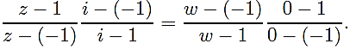
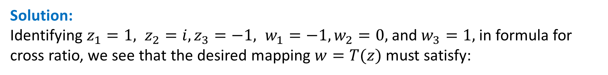
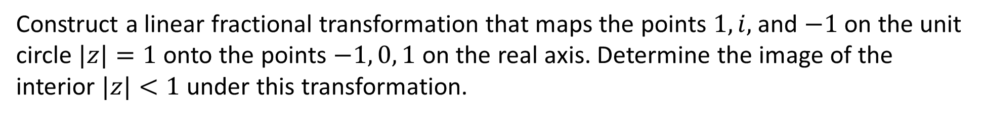

Example:
Construct a linear fractional transformation that maps the points $1,i,$ and $−1$ on the unit circle $|z|=1$ onto the points $−1, 0, 1$ on the real axis. Determine the image of the interior $|z|<1$ under this transformation.
Solution:
Identifying $z_{1}=1, z_{2}=i,z_{3}=−1, w_{1}=−1,w_{2}=0,$ and $w_{3}=1,$ in formula for cross ratio, we see that the desired mapping $w=T(z)$ must satisfy:
After solving for $w$ and simplifying we obtain:
$$w=T\left(z\right)=\frac{z −i }{iz −1 }.$$
Using the test point $z=0,$ we obtain $T(0)=i$. Therefore, the image of the interior $|z|<1$ is the upper half-plane $v>0$.

Slide 37


Example:
Find the linear fractional transformation that maps $z_{1}=−1, z_{2}=i,z_{3}=1$ onto $w_{1}=0, w_{2}=i,$ $w_{3}=∞,$ respectively, such that the unit disk is mapped onto the right half-plane.
Solution:
Using the given points in the formula for cross ratio, we obtain:
$$\frac{z+1 }{z −1 }\frac{i −1 }{i+1 }=\frac{w −0 }{w −∞}\frac{i −∞}{i −0 }.$$
After replacing the ratio $\frac{i −∞}{w −∞}$ by $1$ and simplifying we obtain:
$$w=T\left(z\right)=\frac{z+1 }{1 −z }.$$
Using the test point $z=0,$ we obtain $T(0)=1$. Therefore, the unit disk is mapped onto the right half-plane $u≥0$.

Slide 38
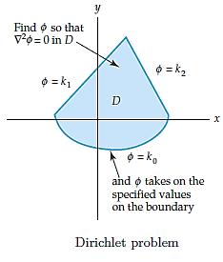
Applications
We have already seen that harmonic functions play an important role in the fields of electrostatics, fluid flow, gravitation, and heat flow.
It is often the case that in order to solve an applied problem in one of these fields we need to find a function $φ(x, y),$ which is harmonic in a domain $D$ and which takes on specified values on the boundary of $D$.
We will now see that mapping by analytic functions can often help solve these types of problems in a simple way.
The specifications of the values of the function φ on the boundary of D are called boundary conditions.

Slide 39
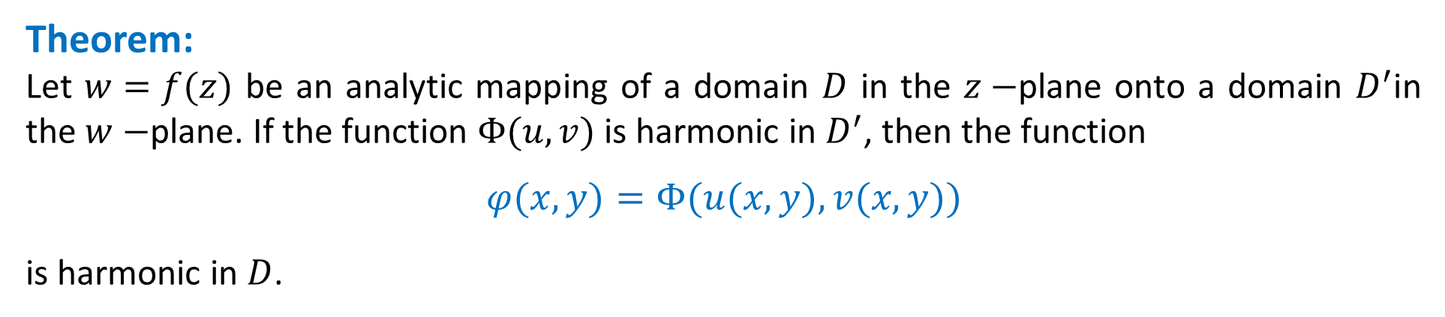
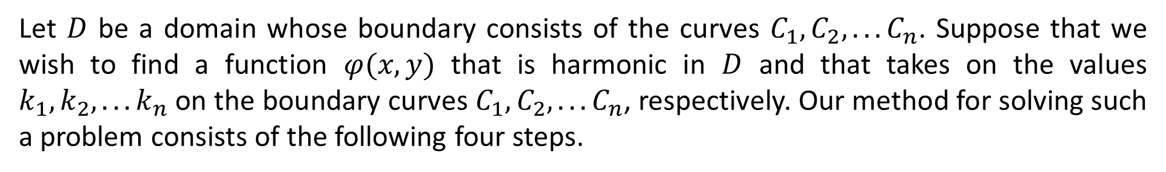
Complicated Dirichlet Problems
A Dirichlet problem in a complicated domain $D$ can be solved by finding an analytic mapping of $D$ onto a domain $D^{′}$ in which the associated, or transformed, Dirichlet problem is easier to solve. The key to this method for solving Dirichlet problems is the following theorem, which shows that Laplace’s equation is invariant under an analytic mapping.
Theorem:
Let $w=f(z)$ be an analytic mapping of a domain $D$ in the $z−$plane onto a domain $D^{′}$in the $w−$plane. If the function $Φ(u,v)$ is harmonic in $D^{′}$, then the function
$φ(x,y)=Φ(u(x,y),v(x,y))$
is harmonic in $D$.
Let $D$ be a domain whose boundary consists of the curves $C_{1},C_{2}, . . .C_{n}$. Suppose that we wish to find a function $φ(x,y)$ that is harmonic in $D$ and that takes on the values $k_{1},k_{2}, . . .k_{n}$ on the boundary curves $C_{1},C_{2}, . . .C_{n}$, respectively. Our method for solving such a problem consists of the following four steps.

Slide 40
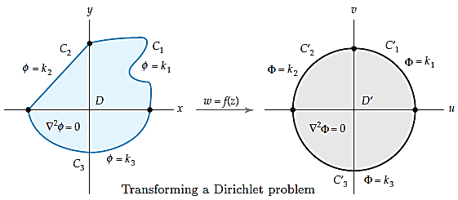
Steps for Solving a Dirichlet Problem
Find an analytic function $f(z)=u(x,y)+iv(x,y)$ that maps the domain $D$ in the $z−$plane onto a simpler domain $D$ in the $w−$plane and that maps the boundary curves $C_{1},C_{2}, . . .C_{n}$ onto the curves ${C_{1}}^{′},{C_{2}}^{′}, . . .{C_{n}}^{′}$, respectively.
Transform the boundary conditions on $C_{1},C_{2}, . . .C_{n}$ to boundary conditions on ${C_{1}}^{′},{C_{2}}^{′}, . . .{C_{n}}^{′}.$
Solve this new (and easier ) Dirichlet problem in $D^{′}$ to obtain a harmonic function $Φ(u,v)$.
Substitute the real and imaginary parts $u(x,y)$ and $v(x,y)$ of $f(z)$ for the variables $u$ and $v$ in $Φ(u,v)$. By theorem, the function $φ(x, y) =Φ(u(x, y), v(x, y))$ is a solution to the Dirichlet problem in $D$.

Slide 41
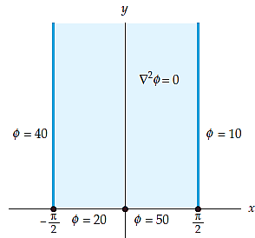
Example: A Heat Flow Application
Find the steady-state temperature φ(x, y) in the vertical semi-infinite strip: $−π/2<x<π/2,$ $y>0$, where the boundary conditions are:
$$φ (−π/2, y)=40, φ(π/2, y)=10, y>0$$
$$φ\left(x,0\right)=\left\{\begin{matrix}20, −π/2< x < 0 \\ 50, 0 < x <π/2.\end{matrix}\right.$$
Solution: The steady-state temperature $φ$ must satisfy Laplace’s equation in $D$. Note that the mapping $w=\sin{z}$ maps:
the half-line $x=−π/2, y>0$, onto the half-line $v=0,u<−1,$
the segment $y=0,−π/2<x<0$ onto the segment $v=0,$ $−1<u<0,$
the segment $y=0,0<x<π/2$ onto the segment $v=0,$ $0<u<1,$ and
the half-line $x=π/2, y>0,$ onto the half-line $v=0,u>1$.
Thus, we conclude that the mapping $w=\sin{z}$ takes the domain $D$ onto the upper-half plane D given by $v>0$.

Slide 42
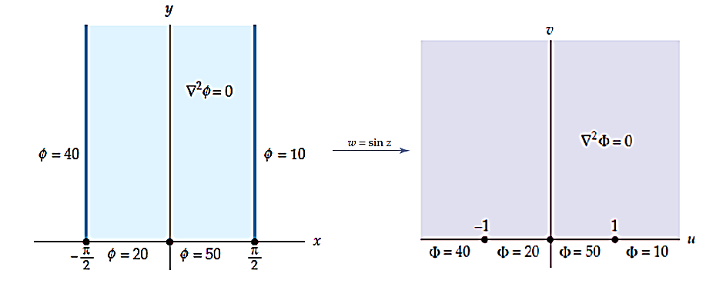

Slide 43

Example: A Heat Flow Application
Thus, the transformed Dirichlet problem is:
A solution of the transformed Dirichlet problem given by:
$$Φ\left(u,v\right)=10+\frac{20}{π } Arg \left(w+1\right)−\frac{30}{π } Arg \left(w\right)+\frac{40}{π }Arg \left(w −1\right). (I)$$
A solution $φ$ of the Dirichlet problem in the domain $D$ is found by replacing the variables $w$ in $(I)$ with analytic function $w=f\left(z\right)=sin⁡z.$ Thus, we have:
$$φ\left(x, y\right)=10+\frac{20}{π } Arg \left(\sin{z}+1\right)−\frac{30}{π } Arg \left(\sin{z}\right)+\frac{40}{π }Arg \left(\sin{z}−1\right).$$

Slide 44

Divergence
Interpreting the Divergence: Divergence (div) is “flux density”—the amount of flux entering or leaving a point. Think of it as the rate of flux expansion (positive divergence) or flux contraction (negative divergence).
Alternatively, we can say that the divergence at a given point measures the net flow out of a small box around the point, that is, it measures what is produced (source) or consumed (sink) at a given point in space.
In other words, div F(x, y, z) measures the tendency of the fluid to diverge from the point (x, y, z). If div F = 0, F is said to be incompressible.

Slide 45


Divergence
Example: Determine whether the divergence of each vector field at the indicated point P is positive, negative or zero
(a)
Draw a box around the point P.
We can clearly see from the magnitude of the vectors that the net flow out of the box is negative (more “stuff” coming in than out).
Thus the divergence is negative and we say the point P is a sink.

Slide 46




Divergence
(b)
Draw a box around the point. We can see that the net flow out of the box is zero (same amount of “stuff” is coming in than coming out).
Thus the divergence is zero and we say that the vector field is incompressible at the point.
Draw a box around the point. The net flow is positive (less “stuff” coming in than out).
(c)
Thus the divergence is positive and we say that the point is a source.

Slide 47




Potential of a Source or Sink
For any two real numbers $k$ and $x_{1}$, the function:
$$Ω\left(z\right)= kLn(z −x_{1}),$$
where $k$ is a positive constant, is analytic in the upper half-plane and therefore is complex potential for the flow of an ideal fluid. The real number $x_{1}$ is a sink when $k<0$ and a source for the flow when $k>0$. The strength of the source or sink is proportional to $|k|$. A flow containing both sources and sinks can be described by adding together functions of the form $(5)$. Note that the complex potential due to source of strength $“k”$at $x_{1}=a$ is: $kLn(z −a),$ while the complex potential due to a sink of strength $“k”$at $x_{2}=b$ is: $−kLn\left(z −b\right).$
$$(5)$$
For example,
$$Ω\left(z\right)=Ln\left(z+1\right)−Ln\left(z−1\right)=Ln\left|\frac{z+1}{z−1}\right|,$$
is a complex velocity potential for the flow of an ideal fluid in the upper half-plane $y>0$ that has a source at $x_{1}=−1$ and a sink at $x_{2}= 1$ of equal strength.

Slide 58

Example: Potential of a Pair of Source Lines (a Pair of Charged Wires)
Determine the potential of a pair of oppositely charged source lines of the same strength at the points $z=c$ and $z=−c$ on the real axis.
Solution: For the present case, we have,
$$Ω\left(z\right)=kLn\left(z−c\right)−kLn\left(z+c\right)=kLn\left|\frac{z−c}{z+c}\right|.$$
The equipotential lines are the curves:
$φ=Re Ω\left(z\right)=k \log_{e}\left|\frac{z−c}{z+c}\right|=constant,$ thus, $\left|\frac{z−c}{z+c}\right|=c_{1}.$
These are circles, as can be shown by direct calculation. The lines of force are
$$Ψ=Im Ω\left(z\right)=k\left(θ_{1}−θ_{2}\right)=constant.$$
The lines of force are the curves along each of which the line segment $S:−c≤x≤c$ appears under a constant angle. As known from elementary geometry, these curves are the circular arcs over S. Hence the lines of force are circles.

Slide 59

Example: Flow with a Source and Sink of Equal Strength
Construct a flow of an ideal fluid in the domain $D$ given by $0<arg⁡(z)< π/4$ with a source at the boundary point $x_{1}=1$and sink of equal strength at the boundary point $x_{2}=3$.
Solution: Note that $f\left(z\right)=z^{4}$ is a conformal mapping of D onto the upper half-plane $v>0$.
Under this mapping, the image of $x_{1}=1$is $u_{1}=1$ and the image of $x_{2}=3$is $u_{2}=81$. Thus, for the present case, we have,
$$Ω\left(w\right)=Ln\left(w−1\right)−Ln\left(w−81\right)=Ln\left|\frac{w−1}{w−81}\right|. (∗)$$
which describes the flow of an ideal fluid in the upper half-plane $v>0$ that has a source at $u_{1}=1$ and a sink of equal strength at $u_{2}=81$. Since the domain $D$ is mapped on the domain $v > 0$by the conformal mapping $w=z^{4}$, we obtain a complex potential function for a flow in $D$ by replacing the symbol $w$ with $z^{4}$ in $(∗)$. This yields:
$$Ω\left(z\right)=Ln\left(z^{4}−1\right)−Ln\left(z^{4}−81\right)=Ln\left|\frac{z^{4}−1}{z^{4}−81}\right|. (∗)$$
Streamlines of this flow are given by $ψ(x, y)=α$, or
$$ψ=Im Ω\left(z\right)=Arg\left(z^{4}−1\right)−Arg\left(z^{4}−81\right)=α.$$

